Slide 1
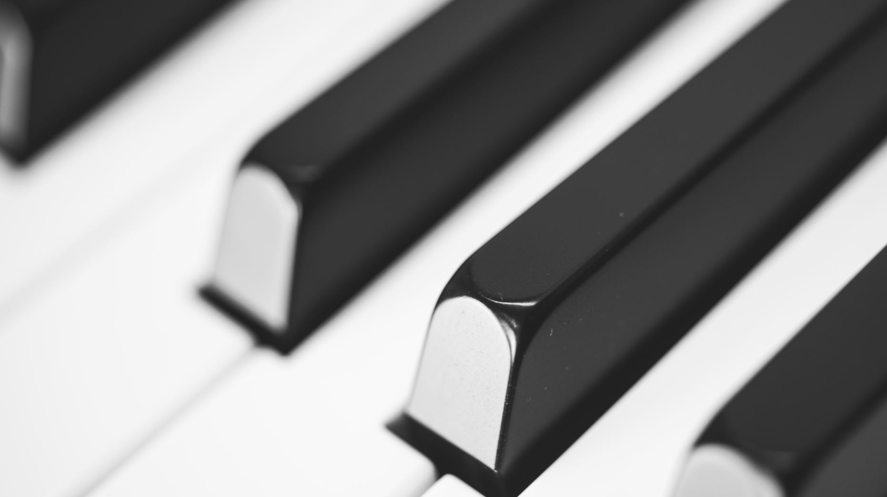
Acoustics of concert Halls
Kian orr, IVc
Mentor: William Spinella

Slide 2
Basics of acoustics
Sound waves
Frequency, amplitude, wavelength, phase difference, intensity
Acoustics
Reverberation, sound absorption, shapes of halls

Slide 3
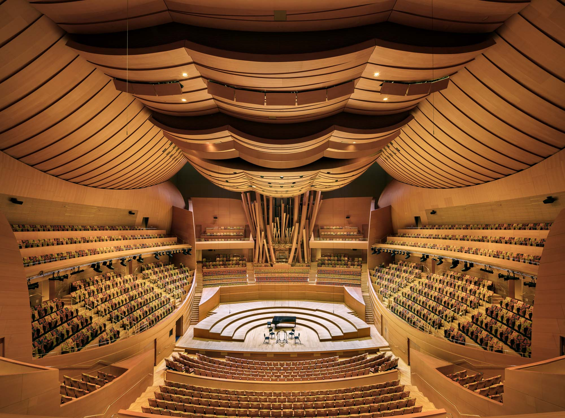
Surround Halls
Strength of sound is weaker because it is sent in a circle
Lack of reverberation

Slide 4
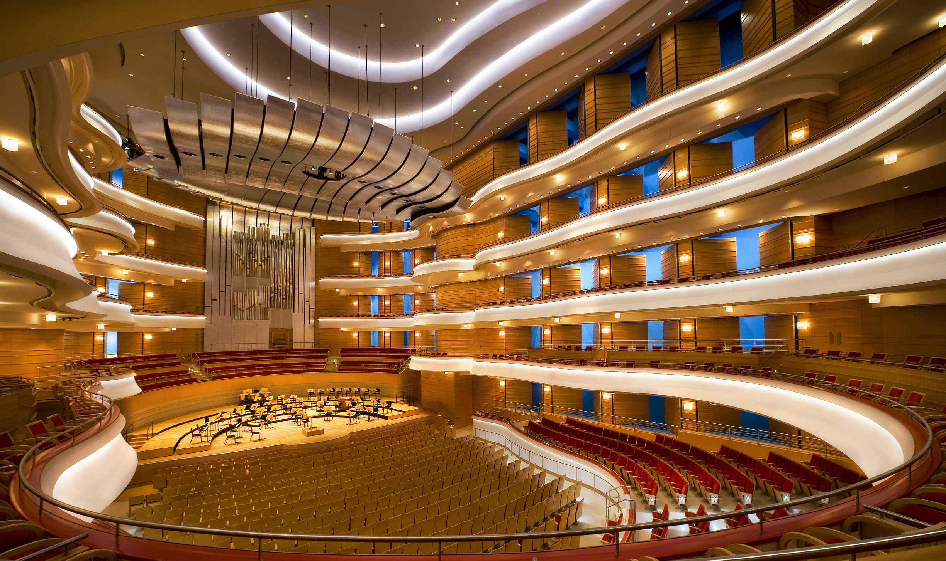
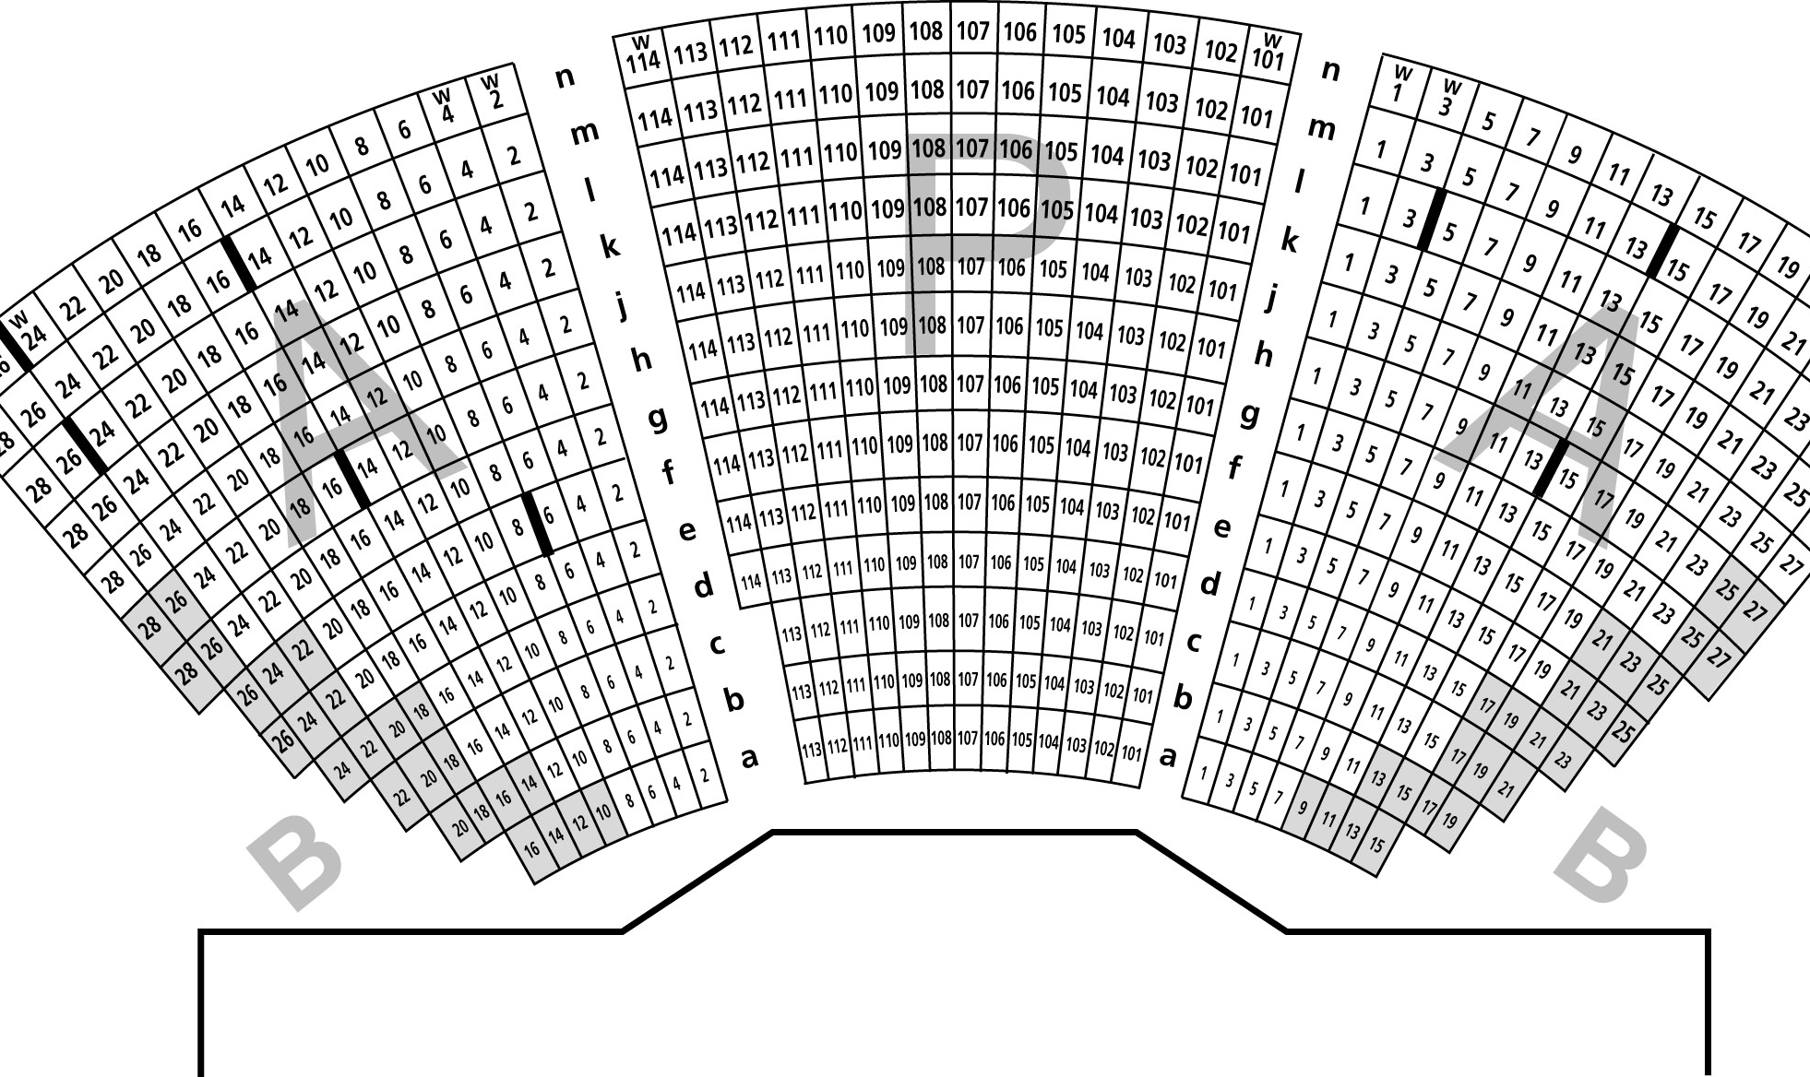
Horseshoe Halls
Sidewalls have seating for the audience members which takes away the possibility of any reverberation occurring in that section
Built for visual aspects and intimacy

Slide 5
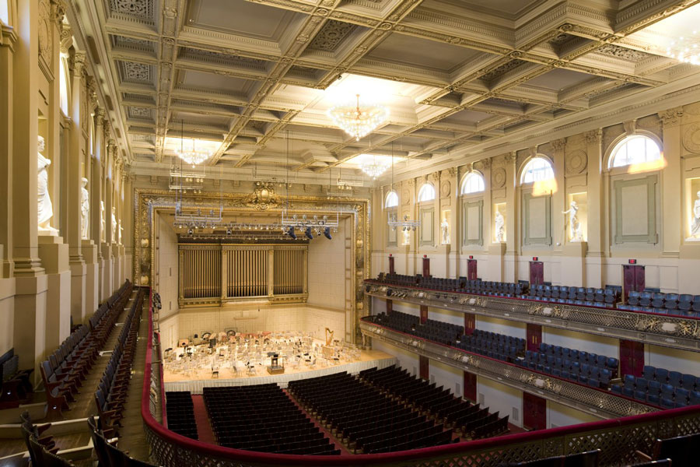
Shoebox halls
Shoebox halls are known to have the best acoustics
Balanced sound
Greater envelopment
Open space in upper walls
Sound arrives at ears where they are most sensitive

Slide 6
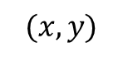
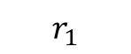
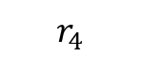

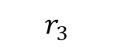

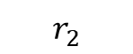
REVERBERATION IN A SHOEBOX HALL
Through geometric relationships, the following were determined:
$$r_{1}=d_{1}\sqrt{{\left(\frac{y}{2d_{1}−x}\right)}^{2}+1}$$
$$r_{2}=\sqrt{{\left[y\left(\frac{2d_{1}−x}{d_{1}}\right)\right]}^{2}+{\left(d_{1}−x\right)}^{2}}$$
$$r_{3}=d_{1}\sqrt{{\left(\frac{y}{2d_{1}+x}\right)}^{2}+1}$$
$$r_{4}=\sqrt{{\left[y\left(\frac{2d_{1}+x}{d_{1}}\right)\right]}^{2}+{\left(d_{1}+x\right)}^{2}}$$
$$r_{5}=\sqrt{x^{2}+y^{2}}$$
$$(x, y)$$
$$r_{2}$$
Wall
$$r_{4}$$
Wall
$$r_{5}$$
$$r_{1}$$
$$r_{3}$$
source

Slide 7
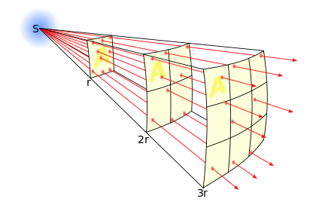
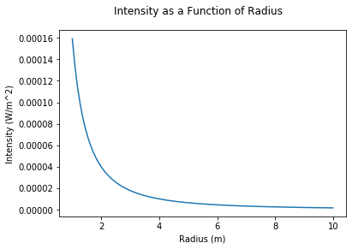
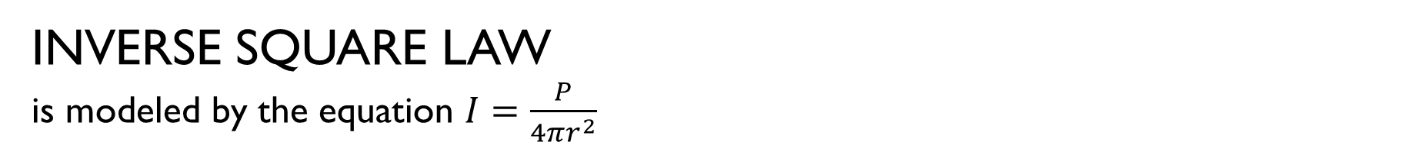
INVERSE SQUARE LAW
is modeled by the equation $I=\frac{P}{4πr^{2}}$

Slide 8
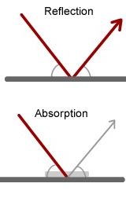
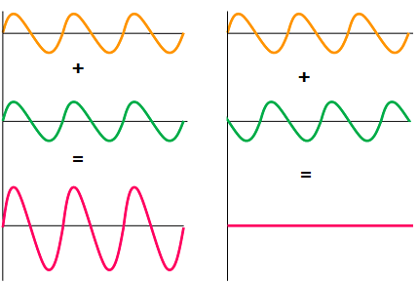
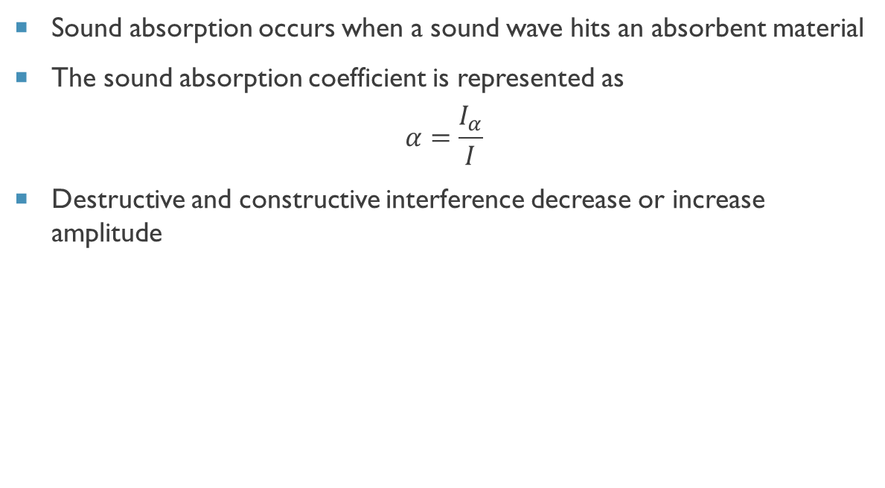
sound absorption and interference
Sound absorption occurs when a sound wave hits an absorbent material
The sound absorption coefficient is represented as
$$α=\frac{I_{α}}{I}$$
Destructive and constructive interference decrease or increase amplitude

Slide 9
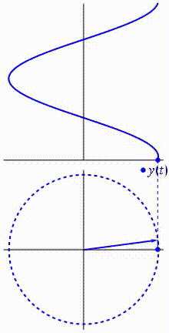
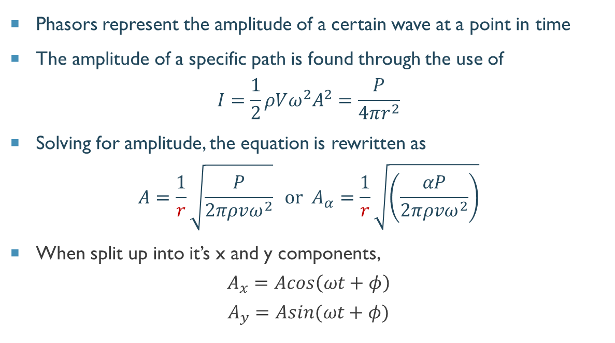
Phasors
Phasors represent the amplitude of a certain wave at a point in time
The amplitude of a specific path is found through the use of
$$I=\frac{1}{2}ρVω^{2}A^{2}=\frac{P}{4πr^{2}}$$
Solving for amplitude, the equation is rewritten as
$$A=\frac{1}{r}\sqrt{\frac{P}{2πρvω^{2}}} \text{or} A_{α}=\frac{1}{r}\sqrt{\left(\frac{αP}{2πρvω^{2}}\right)}$$
When split up into it’s x and y components,
$$A_{x}=Acos\left(ωt+φ\right)$$
$$A_{y}=Asin(ωt+φ)$$
Notes:
The amplitude of the wave can be represented as a vector (the arrow) at a certain time in the waves cycle. Then, using the radii (the position in the concert hall), and the components of the amplitude, the total amplitude at that point in the concert hall is found.

Slide 10
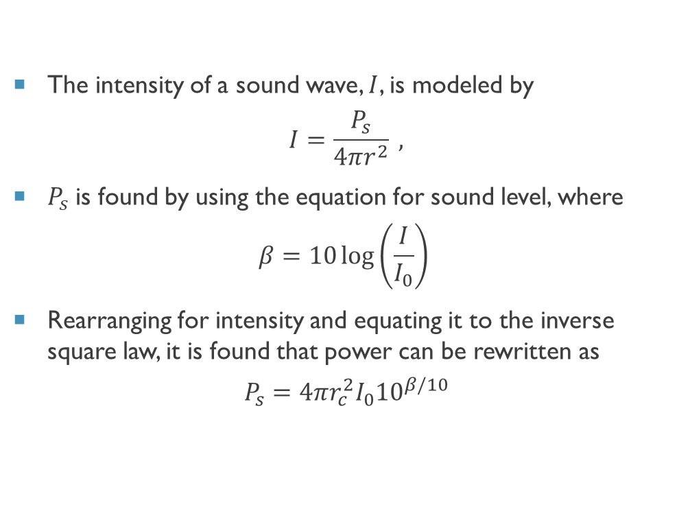
deriving Power
The intensity of a sound wave, $I$, is modeled by
$$I=\frac{P_{s}}{4πr^{2}} ,$$
$P_{s}$ is found by using the equation for sound level, where
$$β=10\log\left(\frac{I}{I_{0}}\right)$$
Rearranging for intensity and equating it to the inverse square law, it is found that power can be rewritten as
$$P_{s}=4πr_{c}^{2}I_{0}{10}^{β/10}$$

Slide 11
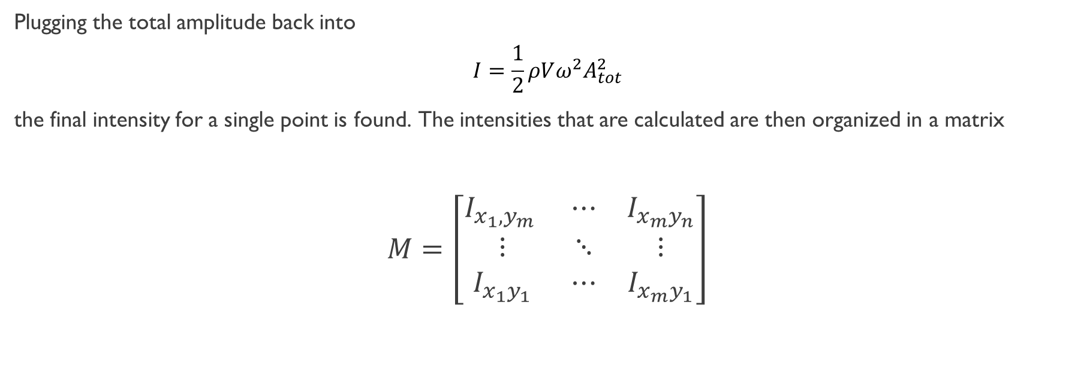
Matrix of intensities
Plugging the total amplitude back into
$$I=\frac{1}{2}ρVω^{2}A_{tot}^{2}$$
the final intensity for a single point is found. The intensities that are calculated are then organized in a matrix
$$M=\left[\begin{matrix}I_{x_{1},y_{m} } & ⋯ & I_{x_{m}y_{n}} \\ ⋮ & ⋱ & ⋮ \\ I_{x_{1}y_{1}} & ⋯ & I_{x_{m}y_{1}}\end{matrix}\right]$$

Slide 12
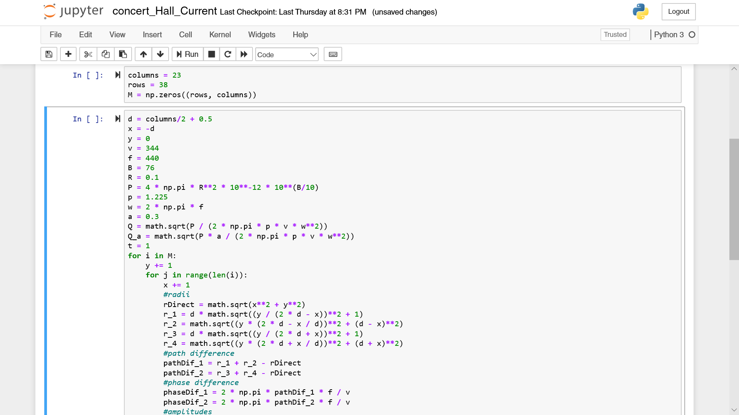
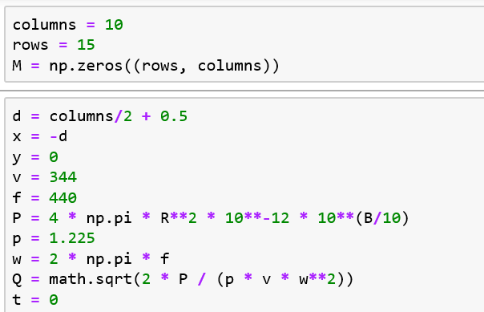
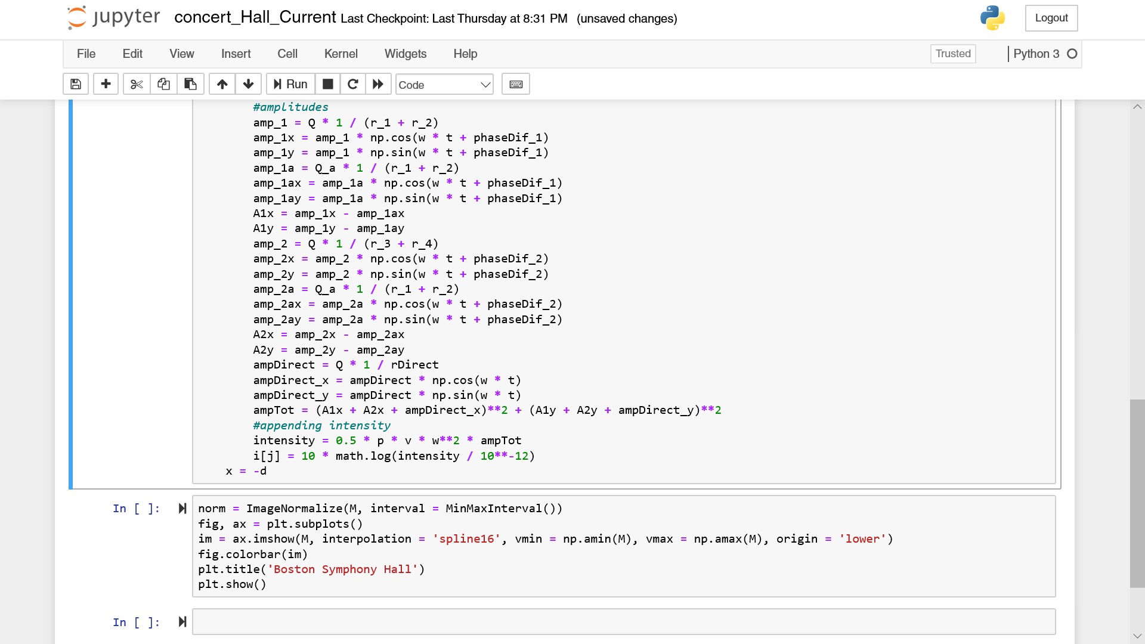
Putting Everything Into Code
Imported numpy, math, matplotlib

Slide 13
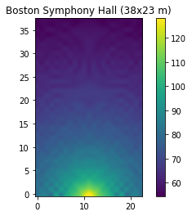
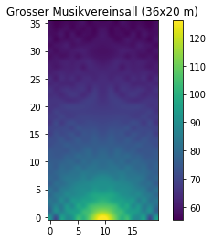
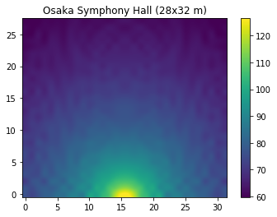

Heat maps of different sized shoebox halls ($α=0)$
Notes:
Significance: different dimensions change the interference patterns drastically

Slide 14
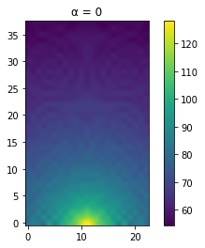


Varying sound absorption in Boston hall
Notes:
Significance: darker spots get lighter until the heat map is uniform
- Too little absorption and there is too much destructive interference and too much absorption, there is not enough reverb

Slide 15
References
Long, Marshall. “What Is So Special about Shoebox Halls? Envelopment, Envelopment,
Envelopment.” Acoustics Today, 31 July 2009,
acousticstoday.org/special-shoebox-halls-envelopment-envelopment-envelopment/
Barron, Mike. (1996). Loudness in concert halls. Acustica. 82. S21-S29.
Engineering ToolBox, (2003). Room Sound Absorption - Sound Absorption Coefficient.
Jeon, Jin Yong & Jo, Hyun-in & Kwak, Kee & Kim, Hyun. (2018). The design goal of acoustic coefficients in concert halls related to reverberation and loudness.
Hidaka, Takayuki & Nishihara, Noriko. (2015). Acoustical quality in concert halls as related to
hall shape: Shoebox, surround, and other.. Psychomusicology: Music, Mind, and Brain. 25. 240-252. http://dx.doi.org/10.1037/pmu0000050240

